Slide 1
ECE 3310 Project
Restaurant Ordering System
Date: 5/6/2026
Osvaldo Perez, Frederick Kamdon, Matthew Lopez Tarsky

Slide 2
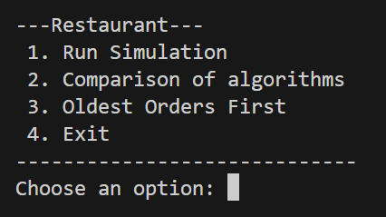
Program Functionality
A console-based program that simulates a Live Restaurant Ordering System which uses hashmaps and a priority queue. This allows for menu items to be stored with a priority value and a priority accumulation rate. These priority values/rates are used to calculate the initial priority value of each order and continue updating the priority value and queue of orders in accordance to each item’s priority rate.
Alongside other data structures and through the usage of hashmaps and a priority queue this C++ program demonstrates dynamic queue management based on a priority value.
Notes:
Fred

Slide 3
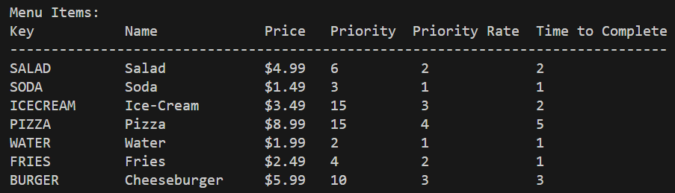
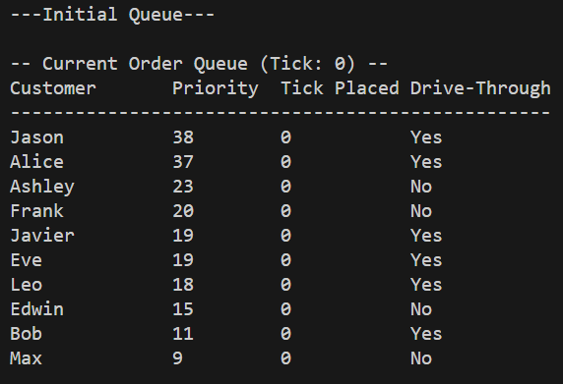
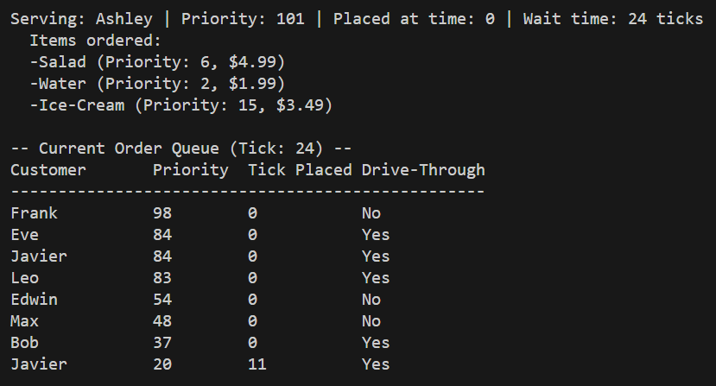
Interface
Run Simulation
Simulates the Restaurant Ordering System
Displays the menu of items stored within the hashmap
Initializes 10 random orders by random customers
Each order is classified by its priority value, tick placement, and if it is a drive-through order or not
Each order is then processed and the queue of orders is updated with new priority values as time passes.
Notes:
Fred

Slide 4
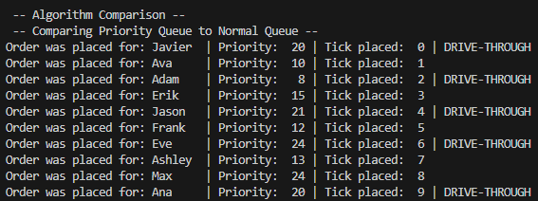
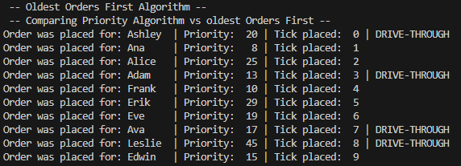
Interface
Comparison of Algorithms
Simulates the Restaurant Ordering System with both a priority queue and normal queue and compares the order process sequences of both.
Oldest Orders First
Similar to the comparison of algorithms, this option runs the Restaurant Ordering System with a priority queue and FCFS algorithm and compares the order process sequences of both
Exit
Closes the program.
Notes:
Fred

Slide 5
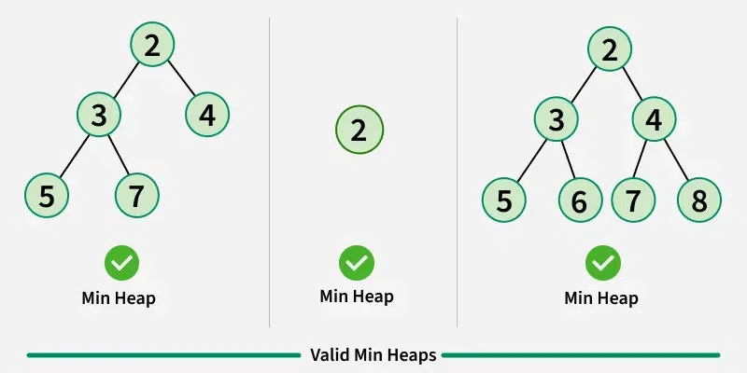
Data Structures & Algorithms Used
Credit: GeeksForGeeks
Multitude of data structures used such vectors, arrays, normal queues, etc. but our main data structure used was a priority queue and hash maps
Priority queue uses a heap, which is a binary tree that is complete (All levels are filled and/or in the left most)
Min heaps are those in which the parent node’s values are less than its children;
Max heaps are those in which the parent node’s values are greater than its children
Pushing and popping the priority queue is O(log(n)), while peaking at the root is O(1). (Heap is sorted when popped or pushed)
C++ STL Priority Queue
priority_queue<Type, Container, Comparator> name;
Type is the object/data type/struct in the queue
Container is how how the data is stored (vector or deque)
Comparator is how the queue determines placement of values
Notes:
Matt

Slide 6
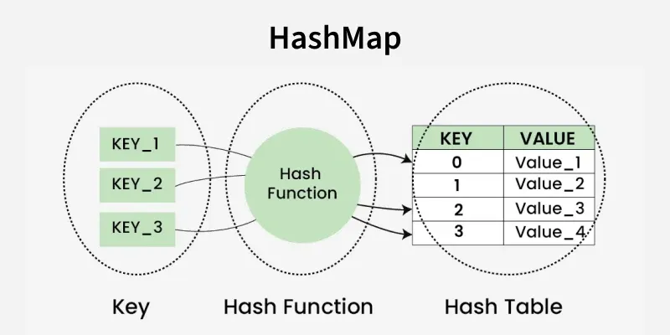
Data Structures & Algorithms Used
Credit: GeeksForGeeks
Hash maps were used for storing the information of items, along with checking for duplicates
Hashes uses a key to value system in which it uses a hash function to store values associated with keys
Finding, adding, and deleting is O(1)
In C++ STL, they are known as unordered maps
C++ STL Priority Queue
unordered_map<Key Type, Value Type> name;
Key Type is the object/data type/struct used to access values in the table
Value Type is the object/data type/struct of the values in the table
Notes:
Matt

Slide 7
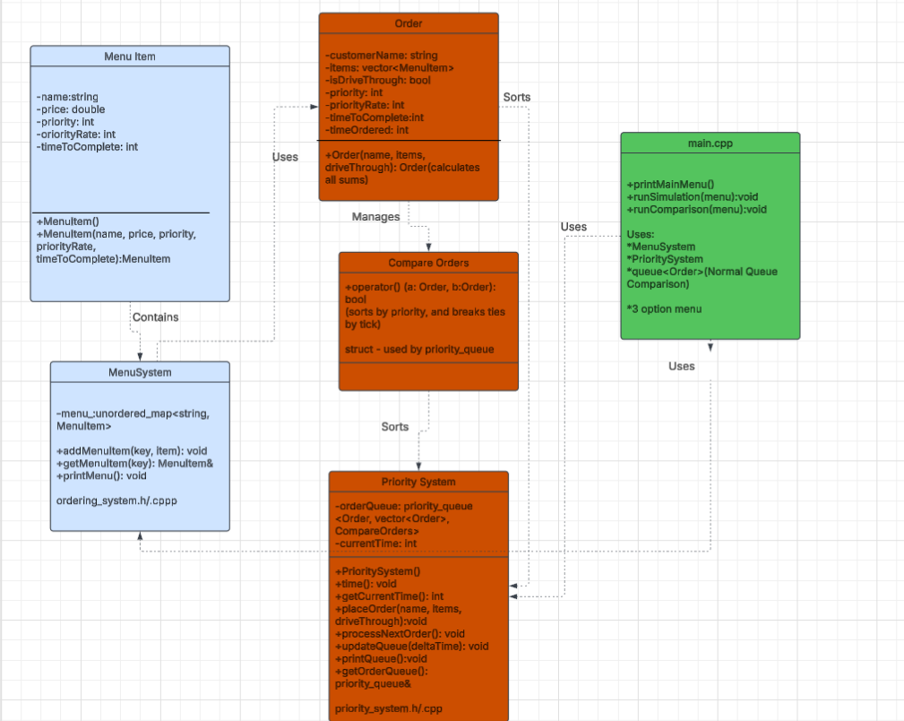
UML
Diagram
Notes:
Osvaldo

Slide 8
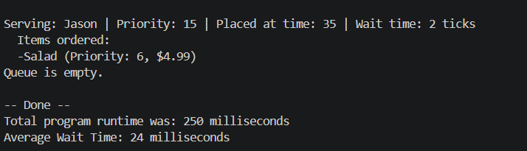
Run Simulation — Option 1
Queue
The Simulation for option 1 in our code is a priority queue (STL priority_queue with CompareOrders)
Simulation
This option will allow random customers to join mid-simulation which would be a 1 in a 10 chance after each order is served.
The orders are being prioritized by priority scores such as drive-through customers and high value items are served first
Display
This will display the initial queue, and will process each order one by one showing the remaining queue after each serving
It will show a track time at the end of the average wait time and total runtime of the program
//Shows how priority queue processes the highest priority first
ps.placeOrder(names[random1], orderItems, (random1 % 2 ==0));
//Shows random mid-simulation customer joining
If (distr1(gen) == 1){
ps.placeOrder(names[distr1(gen1)}, {menu.getMenuItem(keys[distr2(gen2)] }, distr1(gen1) % 2 == 0));
sizeIN ++:
}
Notes:
Osvaldo

Slide 9
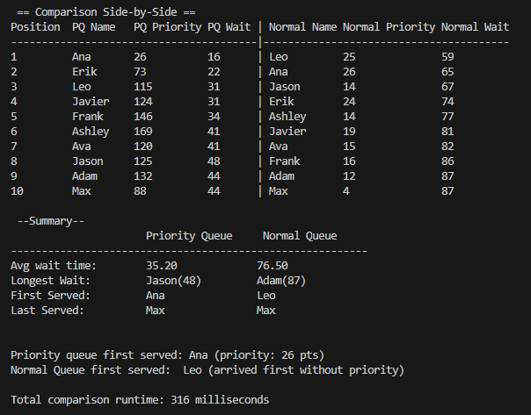
Algorithm Comparison —-Option 2
The two Queues used in this option are
Priority Queue – STL priority_queue with CompareOrders
Normal Queue – STL queue (no sorting just processes the orders as arrived)
10 Random Orders
The program is set to receive 10 random orders from 10 random people but there is a chance where a order will be placed while the program is processing an order.
Both queues will be receiving the same exact customers so it shows a fair comparison between the two
The independent sort we used was wait time = pqTick - order.timeOrdered.
The metrics
The metrics we set up for this were
Avg wait time per queue
Longest wait, first and last served
Plus a side by side table summary on who gets served when
Notes:
Osvaldo

Slide 10
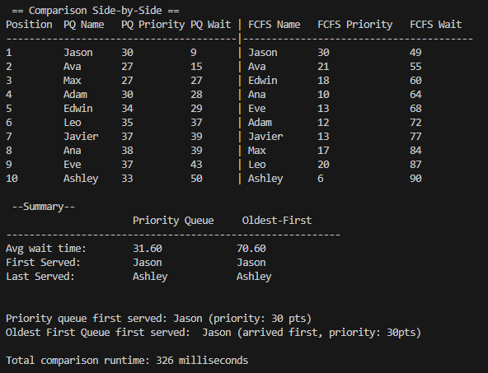
First Come, First Serve —-Option 3
The two Queues in this option are:
Priority Queue – STL priority_queue with CompareOrders
First Come, First Serve (FCFS) - STL priority_queue (sorted by processing oldest orders first)
10 Random Orders
Similar to the previous comparison 10 random orders from 10 random customers are made with the chance for extra orders to be made and both algorithms serve the same orders.
With the possibility of extra orders, this differentiates the processing sequence between the Normal Queue and FCFS.**
The Metrics
The metrics set up for this comparison include:
Summary Table of Orders
Average Wait Time
First Customer Served
Last Customer Served
**Normal Queue will process newly added orders immediately, but FCFS will prioritize the older orders and leave the newly added orders for last.
Notes:
Fred

Slide 11
Dataset
Due to the nature of our program being “live service,” we had to simulate how an actual restaurant would receive and process orders
This was achieved by adding random orders during the programs running, while also making randomizer to make the orders and customers unique every time
For each order, there was a random name chosen, along with a random amount of items in each order.
Performance of each algorithm is determine by avg wait for each session; these sessions are ran multiple time averaged once more to compare algorithms
Parameter | # Used | Info
Names | 10-15 | Unique names for each order (trivial to wait time)
Items | 7 | Type of food item; each item had its own predetermined key, name, price, priority, priority rate, and time to complete.
ps.placeOrder("Frank",{menu.getMenuItem("SALAD"), menu.getMenuItem("WATER")}, false);
Notes:
Matt

Slide 12
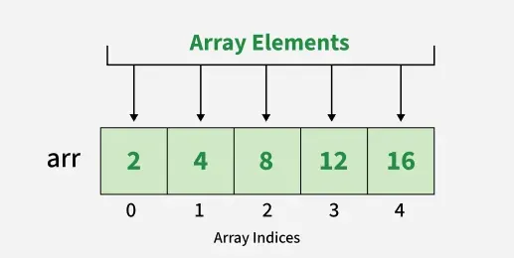
Improvements Used (Runtime)
Credit: GeeksForGeeks
Credit: GeeksForGeeks
In order to prevent duplicates of names being chosen for orders, we had to check if the name was already being used
Solution #1, Use an array:
Everytime a name was chosen it, it was appended to an array, and each time a new time was chosen for a new order, we had to check if the name was already chosen by traversing the array. This is O(n).
Solution #2 (preferred), Use a hash map:
Everytime a name was chosen it, it added to a hashmap as key, along with the random number chosen to be its corresponding value. Everytime we wanted to check for a duplicate, we just needed to provided the randomly chosen name/key and would return if it was chosen or not. This O(1).
Notes:
Matt

Slide 13
Improvements Used (Runtime)
In order to prevent duplicates of names being chosen for orders, we had to check if the name was already being used
Solution #1, Individual Inserts:
After the priority of an order was updated, we added it back to the priority queue. This process takes O(log(n)) but since it has to resort all the items, it does this everytime an item is added, so this process actually takes O(nlog(n)).
Solution #2 (preferred), Entire vector insert :
Instead of only inserting each item, one by one, we can instead add it all at once. This can be achieved by constructing the priority queue with both ends of a vector.
Old: for (auto& order : tempOrders) {
order.priority += order.priorityRate * deltaTime;
orderQueue.push(order);
} New: for (auto& order : tempOrders) {
order.priority += order.priorityRate * deltaTime;
} orderQueue = priority_queue<Order, vector<Order>, CompareOrders>(tempOrders.begin(), tempOrders.end());
Notes:
Matt

Slide 14
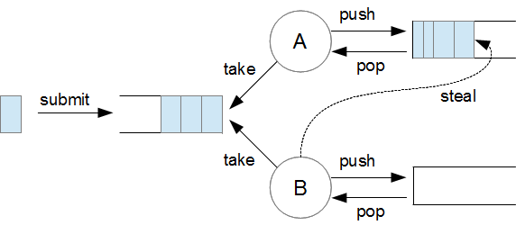
Future Improvements To Priority System
Credit: DZone
Based off our results, we found that priority did not work as well as the oldest first approach.
To improve this, we can perhaps make a more robust way to calculate the priority of an order, such as using time to complete and age.
Multiple Priority Queues
Our program is designed around just one employee, a more realistic settings would be multiple employees, so we can implement multiple queues
Work Stealer Approach
Implement a work stealing algorithm, so that multiple queues can exist and be most efficient
Notes:
Fred

Slide 15
Experimental Campaign
Derived Metrics:
Wait times
Average Wait times
Benchmark procedure:
10 initial customers generated randomly
Random mid-simulation customers have a 1 in 10 chance of joining the queue
To make it fair we made sure the random customers and their orders will be the same for both queues in option 2 and option 3 to show a fair comparison
Goal of Experiments:
To run a simulation that takes the order of 10 random people and their random orders in a priority queue. Also to show the difference of other queues alongside priority queue
Expected Outcome:
Priority queue serves high priority customers faster but can increase wait time compared to a normal queue
 | Run Simulation(Option1) | Comparison Algorithm (Option 2) | Oldest Order First(Option 3)
Queue Type | Priority Queue | Priority vs Normal Queue | Priority vs Time-based Queue
Avg Wait Time | Measured at runtime | Compared side by side | Compared side by side
Random Arrivals | Yes | Yes on both queues | Yes on both queues
Notes:
Osvaldo

Slide 16
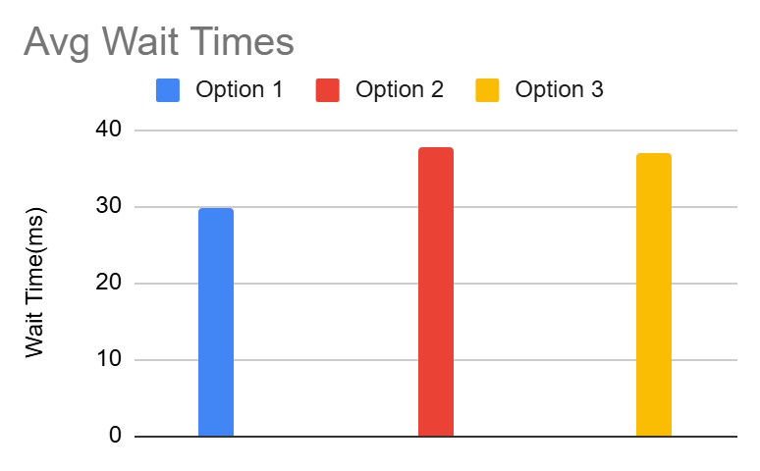
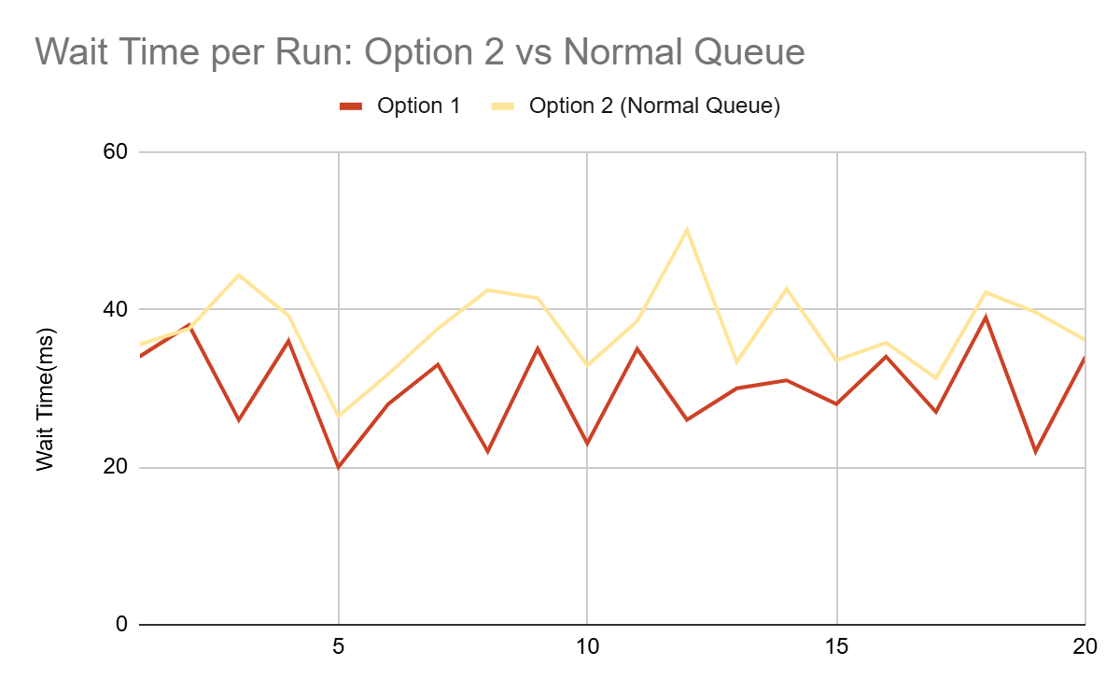
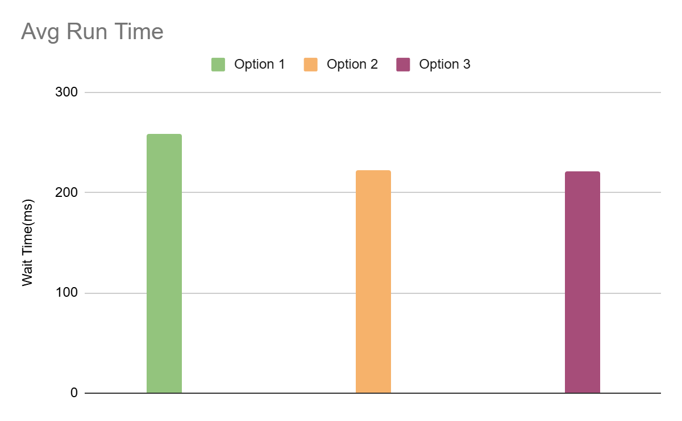
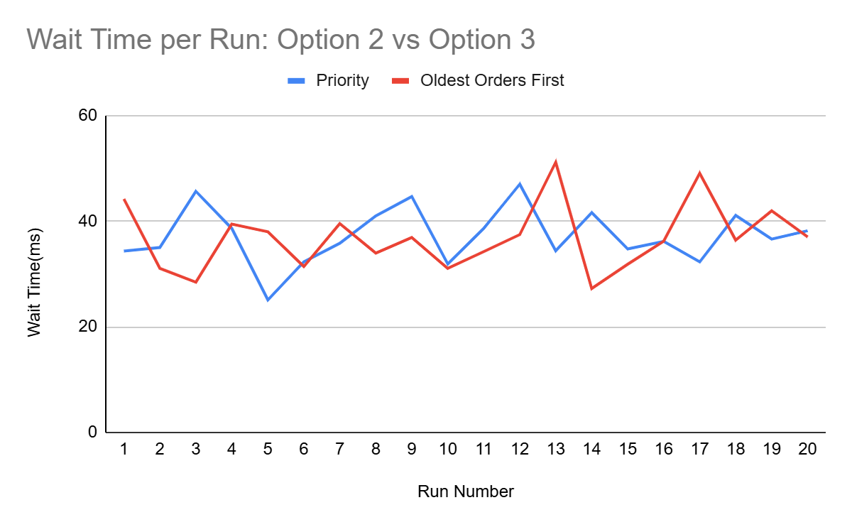
Results
Best Avg Wait Time
Option 1
29.84ms
Fastest Run Time
Option 3
220.74ms
Biggest Wait Difference
Priority vs Normal
7.78ms
Notes:
Osvaldo

Slide 17
Github Repository
https://github.com/mjlt42/ECE-3310-Project

Slide 18
Resources
https://www.geeksforgeeks.org/dsa/heap-data-structure/
https://stackoverflow.com/questions/28311230/precision-time-sleep-using-chrono
https://www.geeksforgeeks.org/cpp/unordered_map-in-cpp-stl/
https://www.geeksforgeeks.org/python/hash-map-in-python/
https://en.cppreference.com/cpp/chrono
https://en.cppreference.com/cpp/container/priority_queue
https://www.youtube.com/watch?v=RBSGKlAvoiM
https://dzone.com/articles/getting-the-most-out-of-the-java-thread-pool
https://youtu.be/QYaQStudgnE?si=3Cvsn64F8I2G9iSb

